Slide 1
Hidden Decision Trees to Design Predictive Scores – Application to Fraud Detection
Vincent Granville, Ph.D.
AnalyticBridge
October 27, 2009
CONFIDENTIAL <number>

Slide 2
Potential Applications
Fraud detection, spam detection
Web analytics
  Keyword scoring/bidding (ad networks, paid search)
  Transaction scoring (click, impression, conversion, action)
  Click fraud detection
  Web site scoring, ad scoring, landing page / advertiser scoring
  Collective filtering (social network analytics)
  Relevancy algorithms
Text mining
  Scoring and ranking algorithms
  Infringement detection
  User feedback: automated clustering

Slide 3
General Model
Predictive scores: score = f(response)
Response:
  Odds of converting (Internet traffic data – hard/soft conversions)
  CR (conversion rate)
  Probability that transaction is fraudulent
Independent variables:
  Rules
  Highly correlated
Traditional models:
  Logistic regression, decision trees, naïve Bayes

Slide 4
Hidden Decision Trees (HDT)
One-to-one mapping between scores and features
Feature = rule combination = node (in DT terminology)
HDT fundamentals:
  40 binary rules → 2⁴⁰ potential features
  Training set with 10MM transactions → 10MM features at most
  500 out of 10MM features account to 80% of all transactions
  The top 500 features have strong CR predictive power
  Alternate algorithm required to classify the 20% remaining transactions
  Using neighboring top features to score the 20% remaining transactions creates bias

Slide 5
HDT Implementation
Each top node (or feature) is a final node from an hidden decision tree
  No need for tree pruning / splitting algorithms and criteria: HDT is straightforward, fast, and can rely on efficient hash tables (where key=feature, value=score)
Top 500 nodes come from multiple hidden decision trees
Remaining 20% transactions scored using alternate methodology (typically, logistic regression)
HDT is an hybrid algorithm
  Blending multiple, small, easy-to-interpret, invisible decision trees (final nodes only) with logistic regression

Slide 6
HDT: Score Blending
The top 500 nodes provide a score S₁ available for 80% of the transactions
The logistic regression provides a score S₂ available for 100% of the transactions
Rescale S₂ using the 80% transactions that have two scores S₁ and S₂
  Make S₁ and S₂ compatible on these transactions
  Let S₃ be the rescaled S₂
Transactions that can’t be scored with S₁ are scored with S₃

Slide 7
HDT History
2003: First version applied to credit card fraud detection
2006: Application to click scoring and click fraud detection
2008: More advanced versions to handle granular and very large data sets
  Hidden Forests: multiple HDT’s, each one applied to a cluster of correlated rules
  Hierarchical HDT’s: the top structure, not just rule clusters, is modeled using HDT’s
  Non binary rules (naïve Bayes blended with HDT)

Slide 8
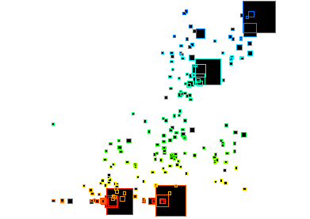
HDT Nodes: Example
Y-axis = CR, X-axis = Score, Square Size = # observations

Slide 9
HDT Nodes: Nodes = Segments
80% of transactions found in 500 top nodes
Each large square – or segment – corresponds to a specific transaction pattern
HDT nodes provide an alternate segmentation of the data
One large, medium-score segment corresponds to neutral traffic (triggering no rule)
Segments with very low scores correspond to specific fraud cases
Within each segment, all transactions have the same score
Usually provides a different segmentation than PCA and other analyses

Slide 10
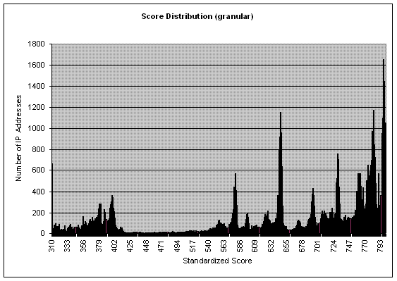
Score Distribution: Example

Slide 11
Score Distribution: Interpretation
Reverse bell curve
Scores below 425 correspond to un-billable transactions
Spike at the very bottom and very top of the score scale
50% of all transactions have good scores
Scorecard parameters
  A drop of 50 points represents a 50% drop in conversion rate:
  Average score is 650.
Model improvement: from reverse bell curve to bell curve
  Transaction quality vs. fraud detection
  Anti-rules, score smoothing (will also remove score caking)

Slide 12
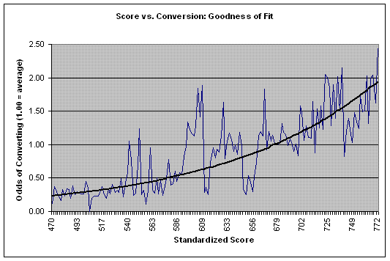
GOF Scores vs. CR: Example

Slide 13
GOF: Interpretation
Overall good fit
Peaks could mean:
  Bogus conversions
  Residual Noise
  Model needs improvement (incorporate anti-rules)
Valleys could mean:
  Undetected conversions (cookie issue, time-to-conversion unusually high)
  Residual noise
  Model needs improvement

Slide 14
Conclusions
Fast algorithm, easy to implement, can handle large data sets efficiently, output is easy to interpret
Non parametric, robust
  Risk of over-fitting is small if no more than top 500 nodes are selected and ad-hoc cross validation techniques used to remove unstable nodes
  Built-in mechanism to compute confidence intervals for scores
HDT: hybrid algorithm to detect multiple types of structures
  Linear and non linear structures
Future directions
  Hidden forests to handle granular data
  Hierarchical HDT’s

